Slide 1
Plan, Schedule, Test Community Portal
Module Project
Module: NICF Capstone Project using Java
Course: NICF-Advanced Certificate in Infocomm Technology (Software and Applications)
Start Date : 22 September 2022
End Date : 31 October 2022
Submission Date : 21 October 2022
Learner Name : Wildan Luqmanul Hakim
Enrollment ID : BDSE-0322/STTB
Presentation Date :

Slide 2
Contents
Document History
Version Number | Effective Date of release | Summary of Included Changes | Author
1 | 4th March 2016 | First Edition | Satya CVS
2 | 23rd Jul 2018 | Changed for Module 6 | Shrinivas K R

Slide 3
Contents
Contents
S. No. | Description
01 | Different Types of Testing
02 | How Different Testing Helps
03 | Tests Selected
04 | Test Schedule
05 | Test Results
06 | Testing Tools
07 | Project Milestone & Tasks
08 | Milestone Feedback & Action Taken
09 | Modifications Made Based on Feedback
10 | Project Results
11 | Proposed Improvements

Slide 4
1. Different Types of Testing
Functional Testing
Unit Test Unit tests are very low level and close to the application's source code. They consist of testing individual methods and functions of your software's classes, components, or modules. Unit tests are typically inexpensive to automate and can be run quickly by a continuous integration server.
Integration Test Integration tests ensure that your application's various modules or services work well together. It could be testing the interaction with the database or ensuring that microservices work together as expected.
User Acceptance Testing Acceptance tests are formal tests that determine whether a system meets business requirements. They require that the entire application be running while testing and concentrate on replicating user behaviors.

Slide 5
1. Different Types of Testing
Non-Functional Testing
Cross-browser testing Cross-browser testing, also known as browser testing, is a quality assurance (QA) process that determines whether a web-based application, site, or page works properly for end users across multiple browsers and devices.
Performance Testing Performance testing is a testing technique that determines the speed, scalability, and stability of an application under a given workload.
Load Testing Load Testing is a type of performance testing that determines the performance of a system, software product, or software application under real life based load conditions.

Slide 6
2. How Different Test Helps
Functional Testing
Unit Testing
Help developers in writing better code
Help developers in detecting bugs earlier.
It makes refactoring the code easier.
User Acceptance Testing
Keeping the cost of ongoing maintenance as low as possible
Improve end-user satisfaction
Improving the robustness and usability of software
Integration Testing
Helps in the identification of module integration issues
Increases test coverage and reliability
Helps to ensure that the integrated modules work properly before moving on to system testing of the entire application

Slide 7
2. How Different Test Helps
Non-Functional Testing
Cross Browser Testing
Reducing repetitive tasks
increased consistency and replicability
Access to information about tests or testing is made simple.
Performance Testing 1. Measure the speed, accuracy and stability of software 2. Performance testing allows you to keep your users happy 3. Improve optimization and load capability
Load Testing 1. Minimizes the cost of failure for organizations. 2. Improves software scalability. 3. Reduces the risk for system downtime.

Slide 8
3. Tests Selected
List the testing methods selected to test the project
Functional Testing
1. Unit Testing
2. User Acceptance Testing (UAT)
Non-Functional Testing
1. Cross Browser Testing

Slide 9
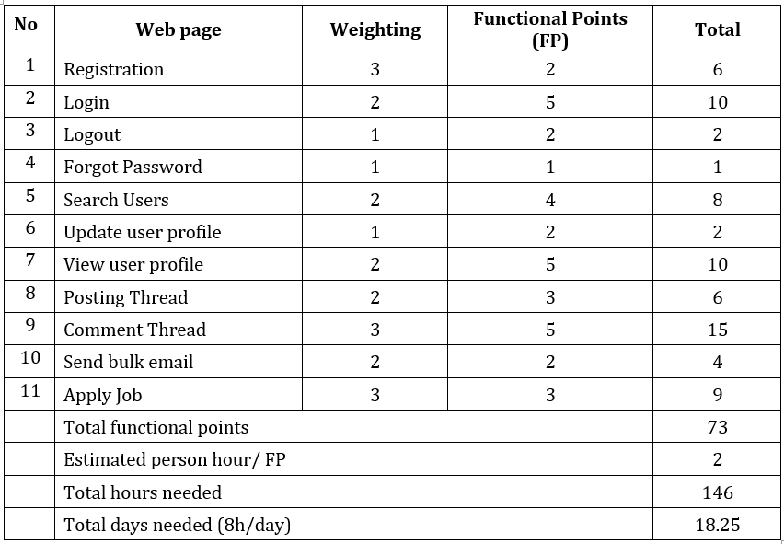
4. Test Schedule
Schedule

Slide 10
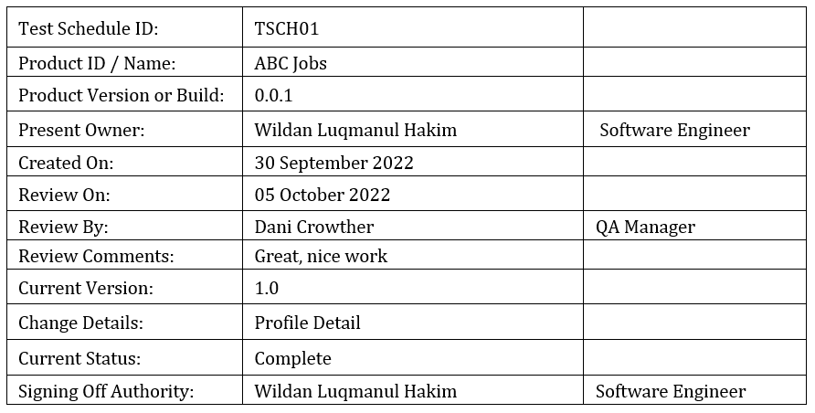
4. Test Schedule
Test Schedule

Slide 11
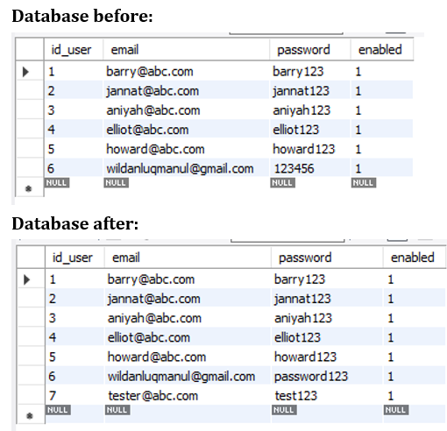
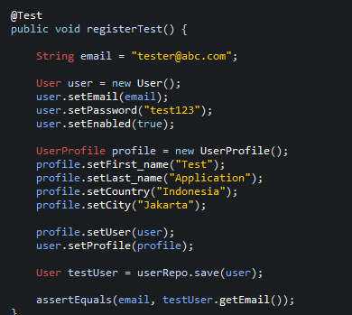
5. Test Results
Unit testing

Slide 12
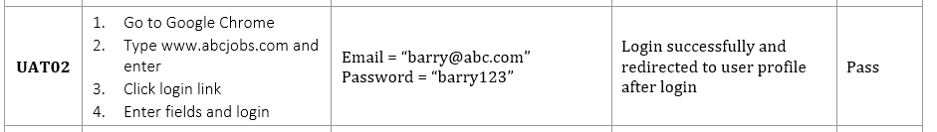
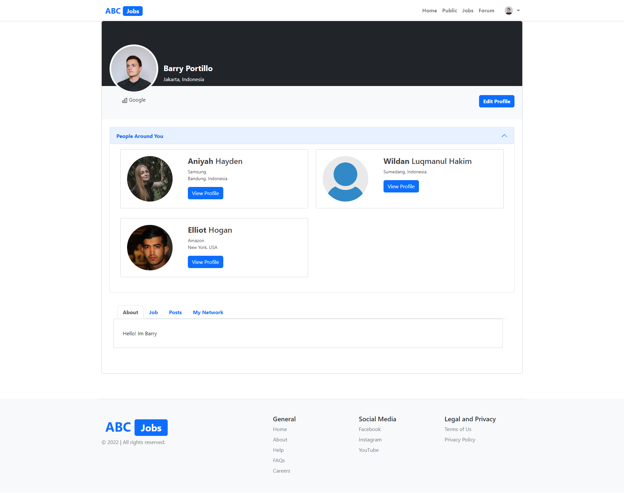
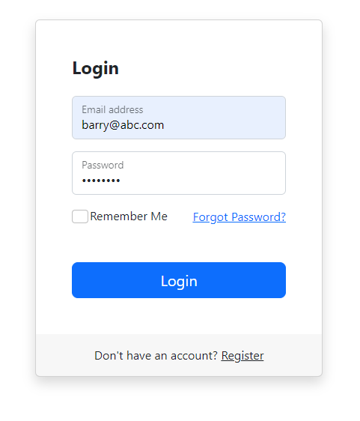
5. Test Results
Unit Acceptance Testing (UAT)

Slide 13
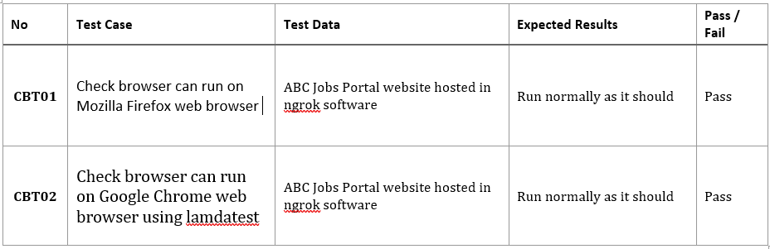
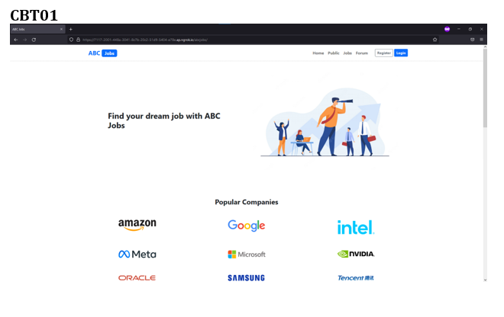
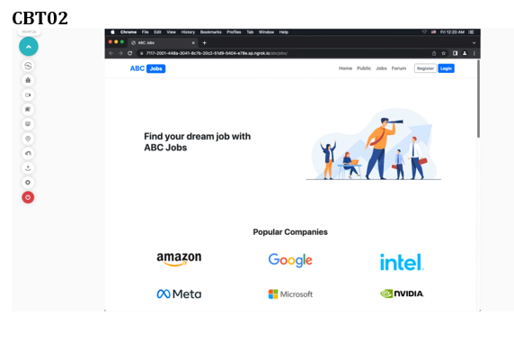
5. Test Results
Cross Browser testing

Slide 14
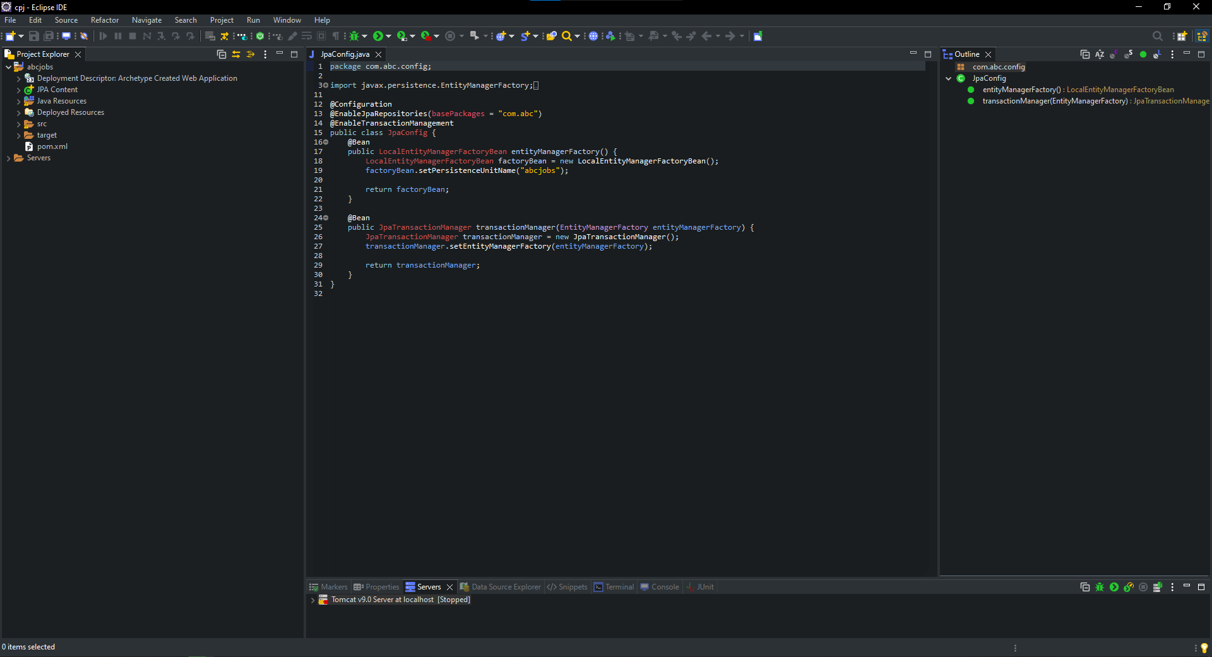
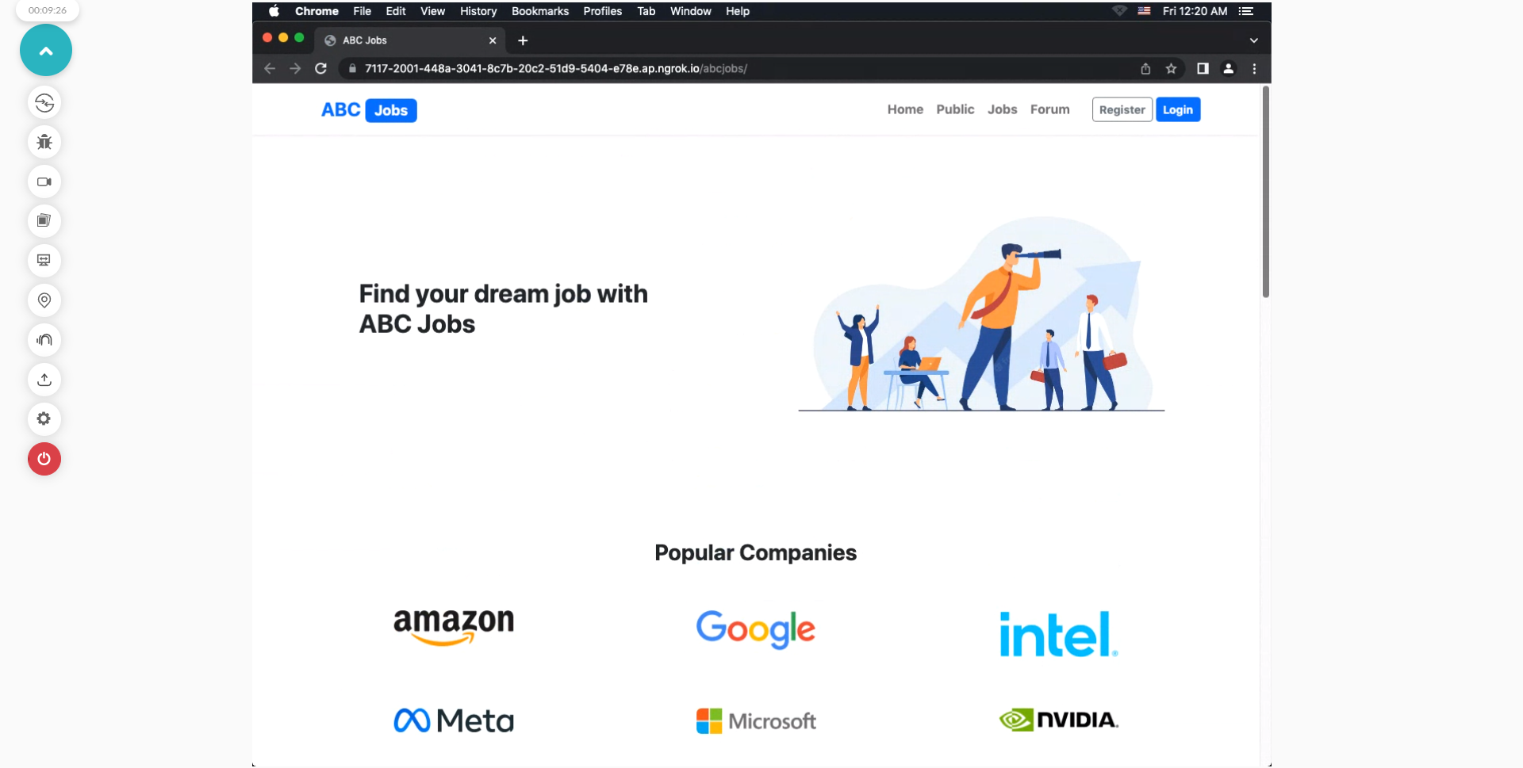
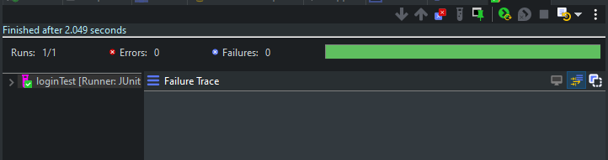
6. Testing Tools Tools
Testing Tools
Eclipse JUNIT4
Lambdatest

Slide 15
7. Project Milestones & Tasks
Project Task ID | Project Task Description | Project Milestone ID
1 | Analyze and suggest choice of Test Methods | 1
2 | Schedule the Test Optimally | 1
3 | Develop the Phase Test Plan | 1
5 | Develop Test Cases & Scripts | 2
6 | Execute the Tests & Document the results | 3

Slide 16
8. Milestone Feedback & Action taken
Project Milestone ID | Milestone Feedback received from Tutor / Learning Facilitator | Action Taken (Yes / No)
1
2
3

Slide 17
9. Modifications Made based On Feedback

Slide 18
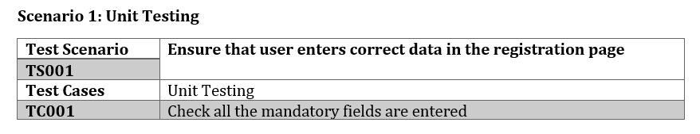
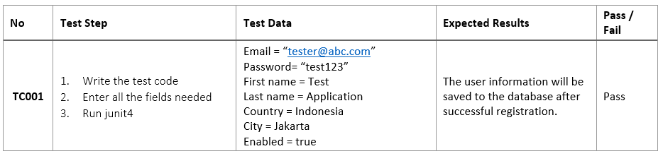
10. Project Results

Slide 19
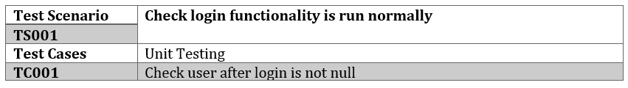
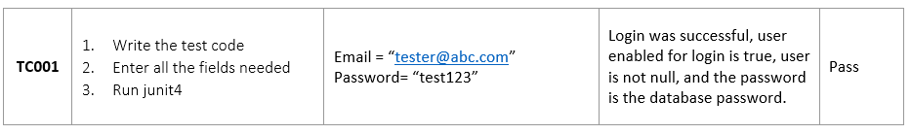
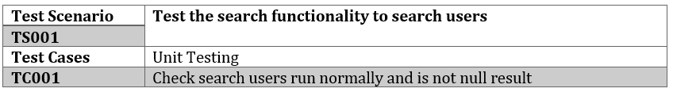
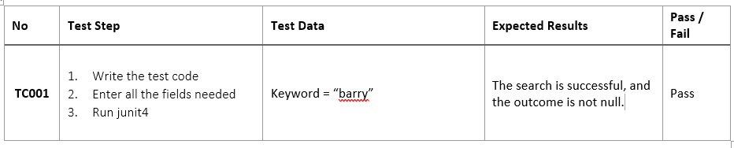
10. Project Results

Slide 20
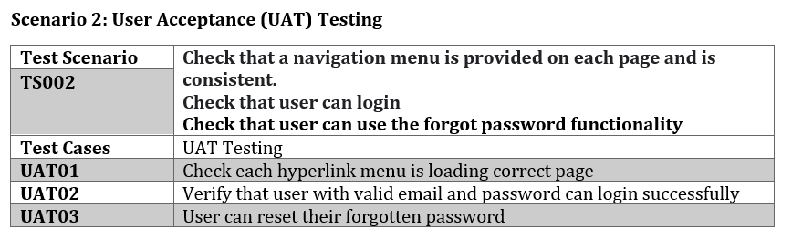
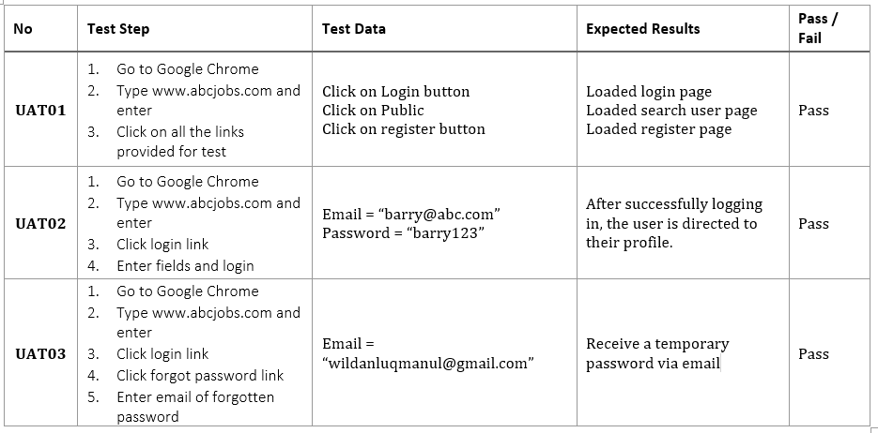
10. Project Results

Slide 21
11. Proposed Improvements
List of Improvements
Make the test more detailed and understandable for everyone
Learn more about the test application or website
Improve test results even better

